Slide 1







Virtual Classroom Tutorial
To listen to the tutorial, select
Slideshow > Play from Beginning

Slide 2

Independent Work Virtual Classrooms
How to use these resources:
This virtual classroom resource is aligned to each Benchmark Unit and designed to be used during Independent Work…both independently and independent of the teachers’ lessons. (Meaning, it doesn’t have to follow any particular lesson on any particular day or in any particular order.)

Slide 3
Independent Work Virtual Classrooms
How to use these resources:
This virtual classroom resource is aligned to each Benchmark Unit and designed to be used during Independent Work…both independently and independent of the teachers’ lessons. (Meaning, it doesn’t have to follow any particular lesson on any particular day or in any particular order.)
Ideally, it will be used as many days as you need it at any time during your instruction. Students can re-visit the same links several times.

Slide 4
Independent Work Virtual Classrooms
How to use these resources:
This virtual classroom resource is aligned to each Benchmark Unit and designed to be used during Independent Work…both independently and independent of the teachers’ lessons. (Meaning, it doesn’t have to follow any particular lesson on any particular day or in any particular order.)
Ideally, it will be used as many days as you need it at any time during your instruction. Students can re-visit the same links several times.
These activities are from or connected to Benchmark Advance except for the ART lesson. The art should not replace a component of the curriculum.

Slide 5
Independent Work Virtual Classrooms
How to use these resources:
This virtual classroom resource is aligned to each Benchmark Unit and designed to be used during Independent Work…both independently and independent of the teachers’ lessons. (Meaning, it doesn’t have to follow any particular lesson on any particular day or in any particular order.)
Ideally, it will be used as many days as you need it at any time during your instruction. Students can re-visit the same links several times.
These activities are from or connected to Benchmark Advance except for the ART lesson. The art should not replace a component of the curriculum.
These materials can be used for both in-person learning and distance learning.

Slide 6
Independent Work Virtual Classrooms
Tech tips:
  Students need to view these slides in “Presenter View" for the links to work. [In the Powerpoint menu go to “View,” then “Presenter View” ]
  After students click on a link, they need to return to the Power Point.
  You may change the Bitmoji of the teacher if you wish
  EPIC code: uqx7813 See directions here.

Slide 7
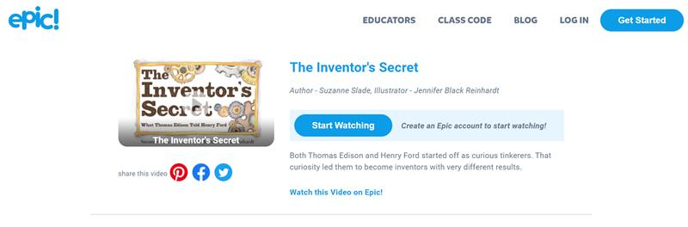
EPIC Directions
When students click on the icon, they will see this:
Click on: Class Code (not “start watching”)
From here, you can choose: “Mrs. Avery’s Class Code.” I have already set this up: uqx7813
OR, you can create your own FREE account https://www.getepic.com/
before sending out this power point. That way you can share your own “Class Code.”
I suggest walking students through this before assigning this Independent Work.

Slide 8
Table of Contents
Simply click on the photos on the slide to visit the following links:
Library Access:
Washoe County Library access
Handouts
See student consumable “Solving Problems Through Technology”
Readings
Read aloud: Queen Victoria’s Bathing Machine by Gloria Whelan
Read aloud: Papa’s Mechanical Fish by Candace Fleming
Read aloud: John Henry by Julius Lester
Read: Frank Einstein and the Electro-Finger by Jon Scieszka (Epic) uqx7813
Read: How the Sphinx Got to the Museum by Jesse Hartland (Epic) uqx7813
Videos:
Watch: Ted Talk by William Kamkwamba, author of The Boy Who Harnessed the Wind
Field Trips:
Through Discovery Education: “The Tech Interactive: Tech for Tomorrow” Virtual Field Trip
Through Discovery Education: “Mars Rover Curiosity” Virtual Field Trip
Participate in the Art Lesson tutorial: Drawing the Mona Lisa by genius inventor and artist, Leonardo DaVinci

Slide 9




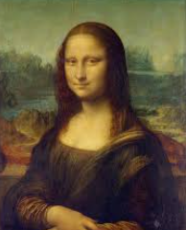


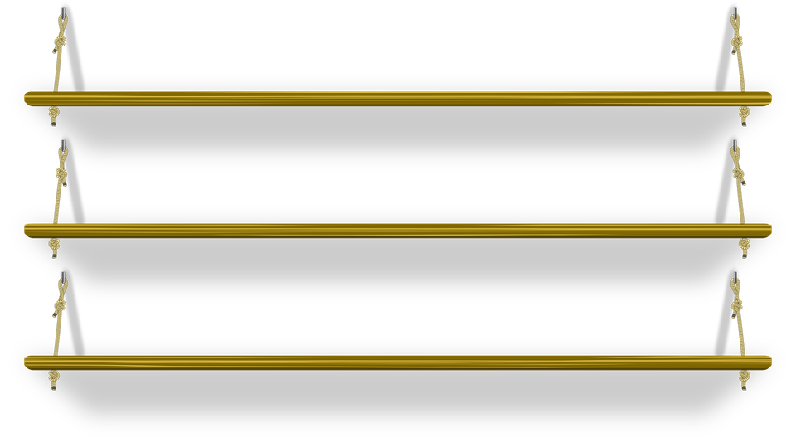


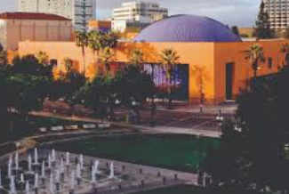









GRADE 2 UNIT 5
Independent Time
Solving problems through technology

Slide 10
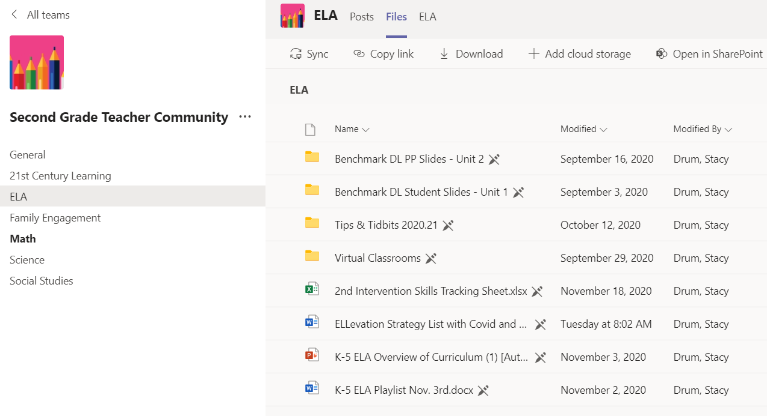

Slide 11

Feedback encouraged.
Kelly S. Avery kelly.avery@washoeschools.net
Kacey Edgington kedgington@washoeschools.net

